Slide 1
Introduction to Extended Security of Lattice-Based Cryptography
Thesis of Mélissa Rossi (2020)

Slide 2



Mélissa Rossi

Slide 3
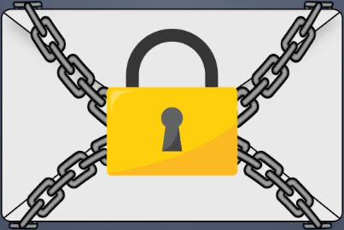
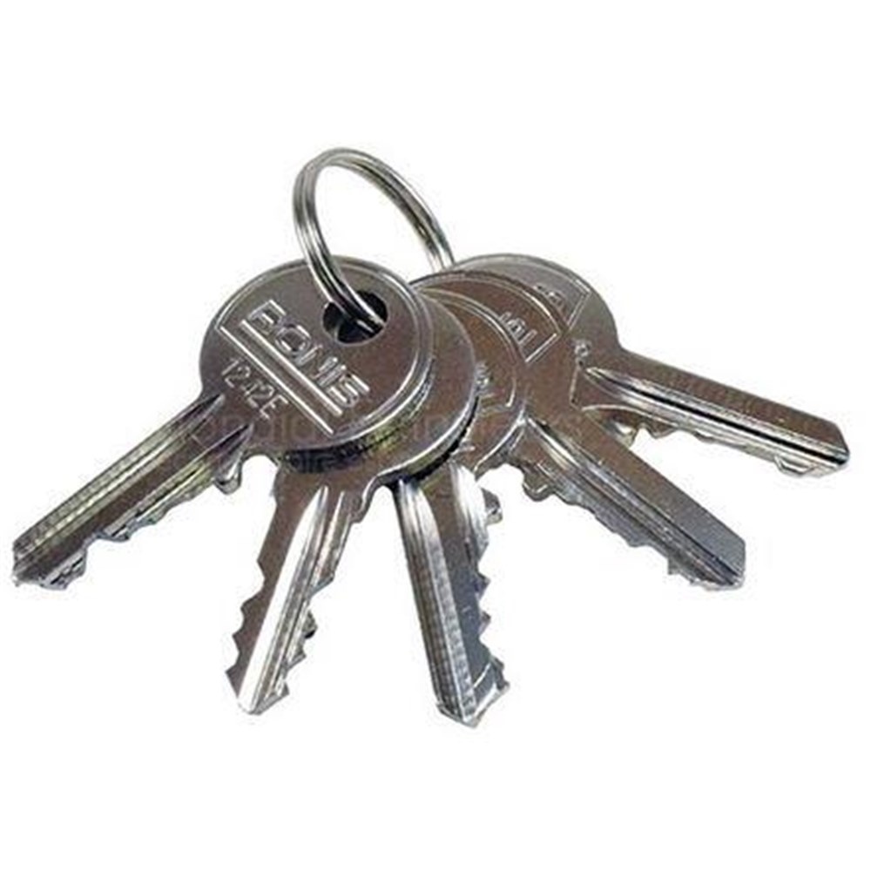
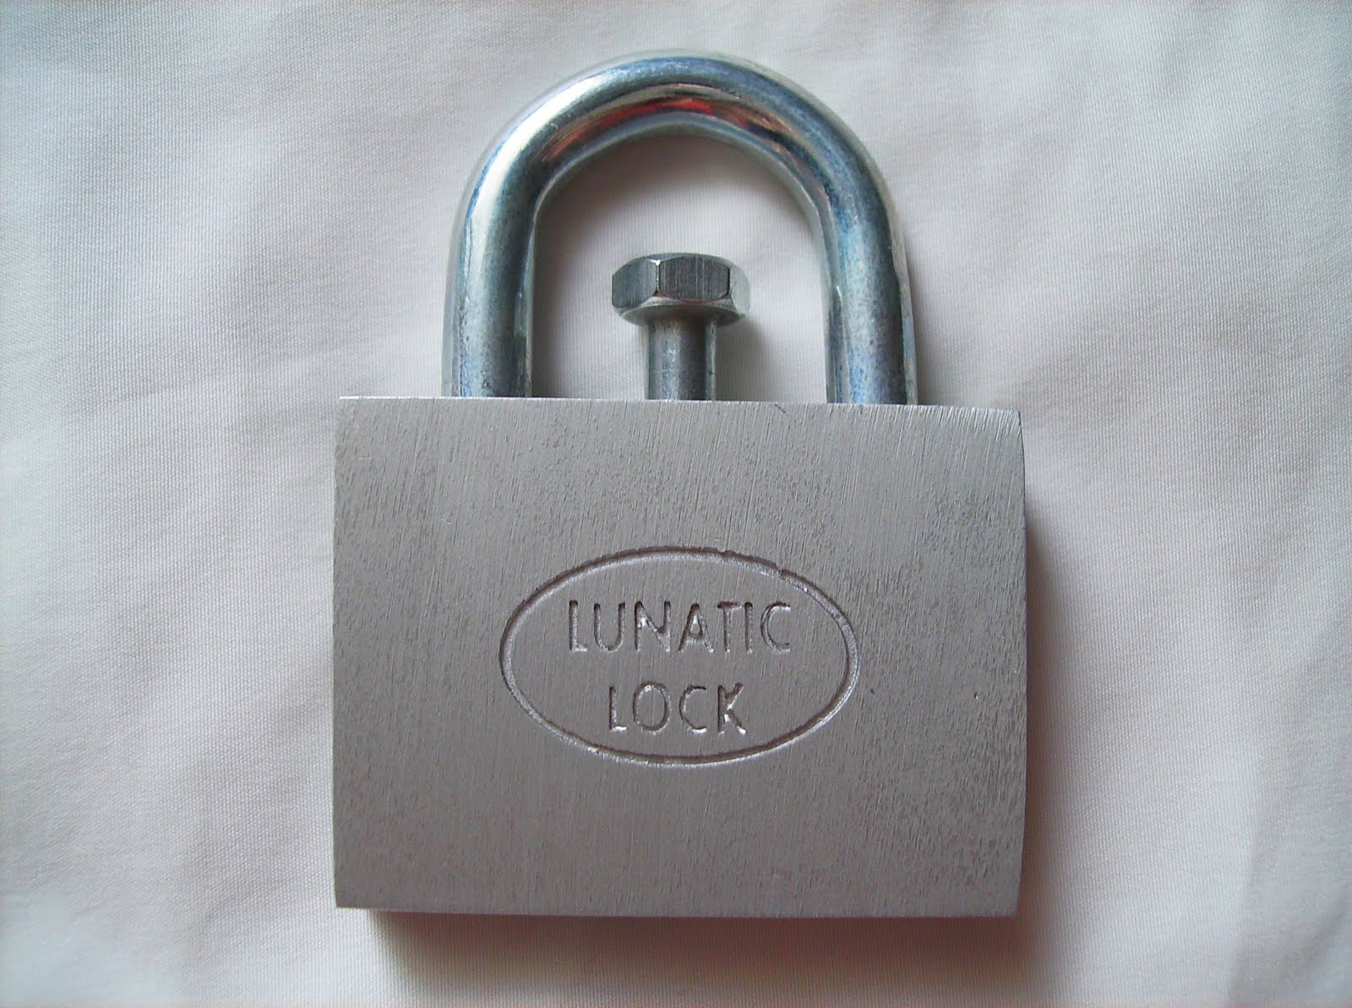
Examples

Slide 4
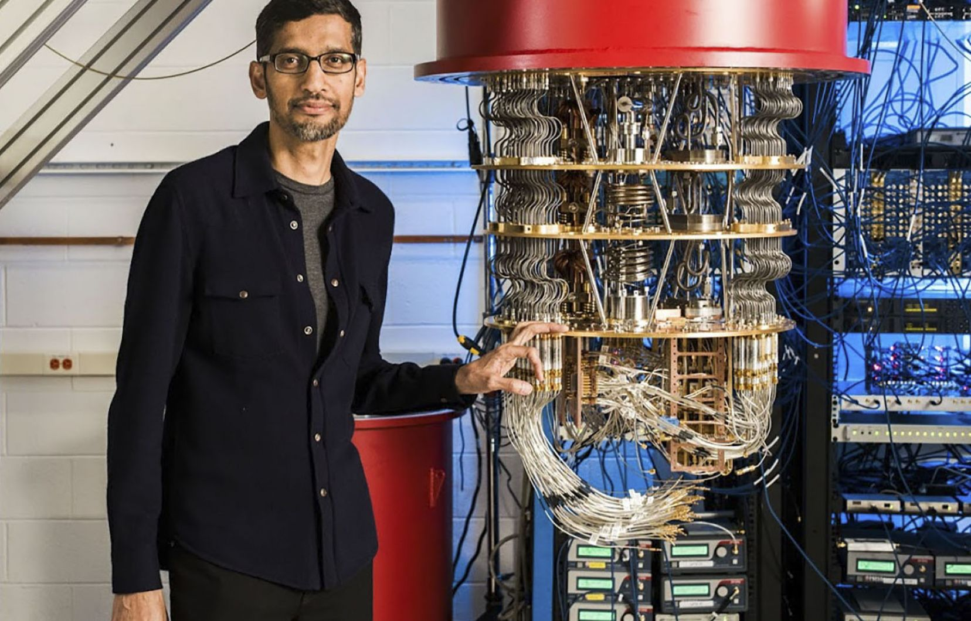

Algorithm … ?
N = p * q
N = p * q
N = p * q
N = p * q
N = p * q
N = p * q
g^x = a [p]
N = p * q
N = p * q
N = p * q
N = p * q
N = p * q
N = p * q
N = p * q
712 854
N = p * q
N = p * q
N = p * q
N = p * q
N = p * q

Slide 5
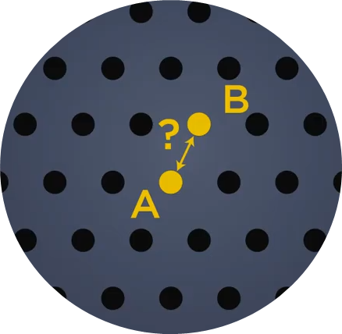
That difficult ?
Difficulty
Dimensions

Slide 6

Links and keywords
Source
Difficult keywords
Questions?
https://www.di.ens.fr/~mrossi/docs/thesis.pdf
https://www.youtube.com/watch?v=G23kfRJGH0k
https://melissarossi.fr/
Lattices : Réseau euclidien
Schemes : plans
Large array : large {choix, gamme, éventail, palette}
Broad spectrum ⬄ Large array
Leveraging : exploiter, mettre à profit , susciter
Addressing : Promouvoir

